Slide 1

Introduction to ACCESS NWP
Chris Tingwell
Bureau of Meteorology R&D Branch Earth Systems Modelling Program Data Assimilation Team
ACCESS Users Training Workshop March 23rd 2016

Slide 2
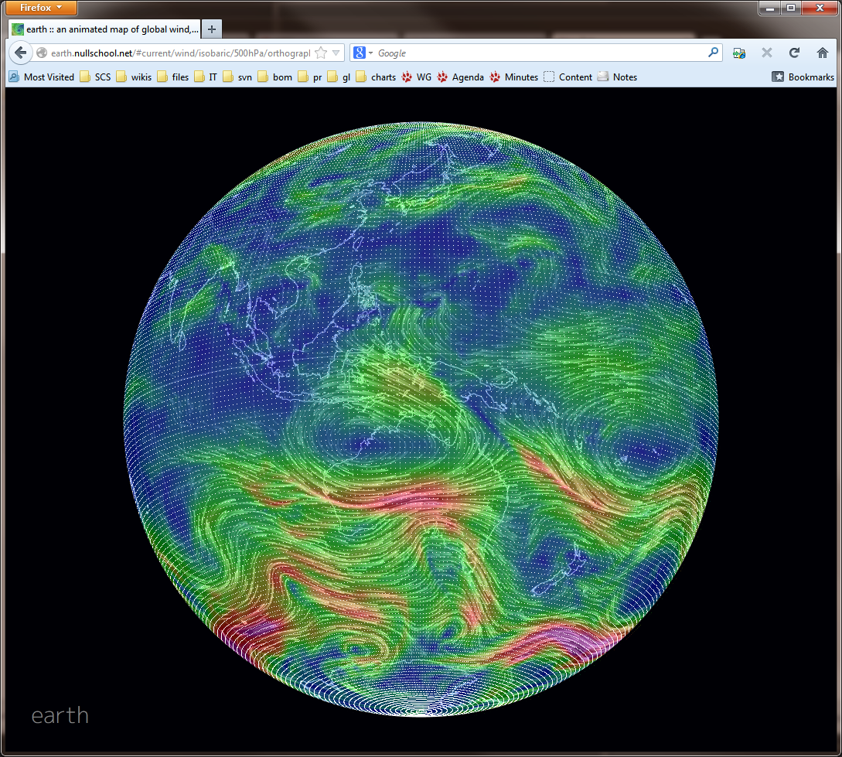
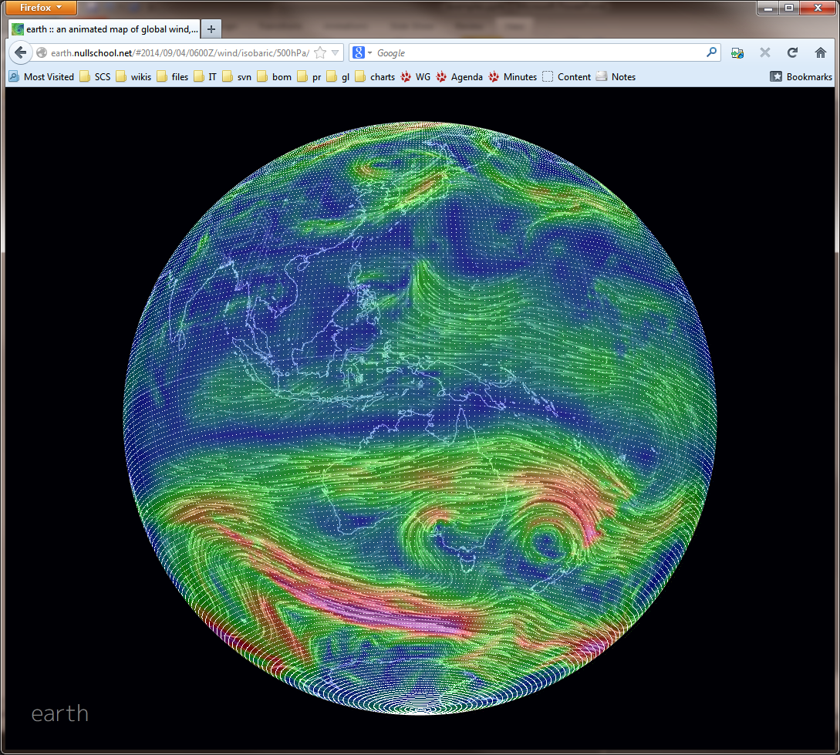
NWP in a nutshell
Boundary conditions
F = ma
Model
NOW initial condition
FUTURE forecast

Slide 3
NWP in a nutshell
Boundary conditions
Land surface model, ancillaries
UM
Model
Data Assimilation
OPS + VAR
FUTURE forecast

Slide 4
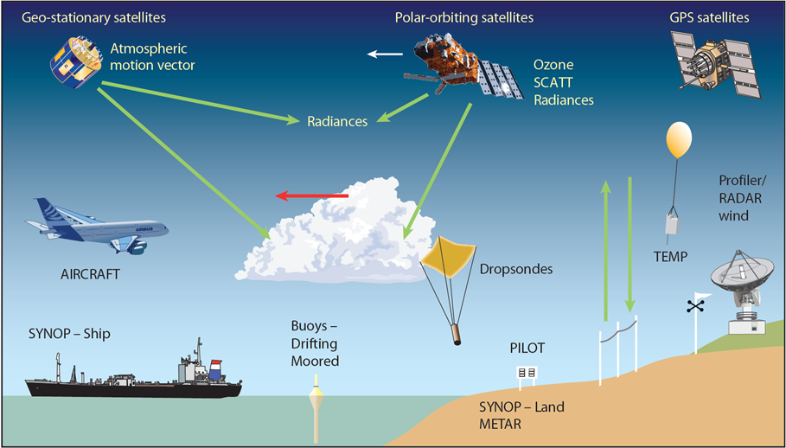
The initial condition: Data Assimilation
The problem:
The model state may consist of ~50 million grid points and 7 meteorological variables at each point - 350 million pieces of information …
but we may actually assimilate "only" 3 – 4 million individual observations, many of which are indirect (particularly in the case of satellite observations)

Slide 5
What a data assimilation system has to do
Create initial condition for the model
Also an accurate analysis of the atmosphere
Only include features that are supported by the model
Filter out small scale imbalances that lead to spurious gravity waves (initialisation).
Use vast amount of data
Account for differences in time, space, variable, scale and accuracy
Data can be indirect and most data are indirect: satellite radiances, GPS signals, radar etc.
Account for complex & non-linear relationship between observed and basic variables
Use the previous forecast as "background"
Represents previous observations projected forward in time
Important source of data, independent of current observations
Necessary as number of grid values >> number of observations

Slide 6
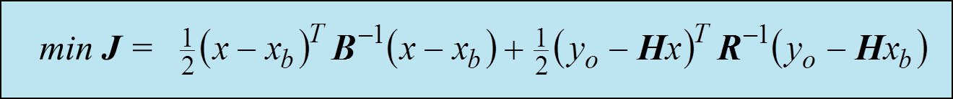
Data assimilation: 4dVAR
model
state
Assimilation cycle repeats every 6 hours
J_{o}
J_{o}
first guess
(previous forecast)
J_{b}
new forecast (3 days/10 days)
analysis
J_{o}
J_{o}
J_{o}
observations
the new initial condition
is initialised (usually with a digital filter)
6 hours
time
t-3
t₀
t+3
00/06/12/18 UTC

Slide 7
Observation processing
In-situ/ conventional, AMVs (GTS, local)
VAR screen-level
analysis
JULES
Soil moisture
RTDB
nudging
ODB
OPS
4D VAR
UM
BUFR
IC
MARS
QC, thinning, bias correction
Direct assimilation of
radiances in the presence of all other observations. Observations used at correct observing time
SST
Sea-ice
Satellite (Exeter, local, AP-RARS)

Slide 8
Six hour analysis – forecast cycle
FG
OPS
VAR
UM
IC
+6h
forecast
FG
OPS
VAR
UM
6 hours later
IC
+6h
FG
OPS
VAR
6 hours later

Slide 9

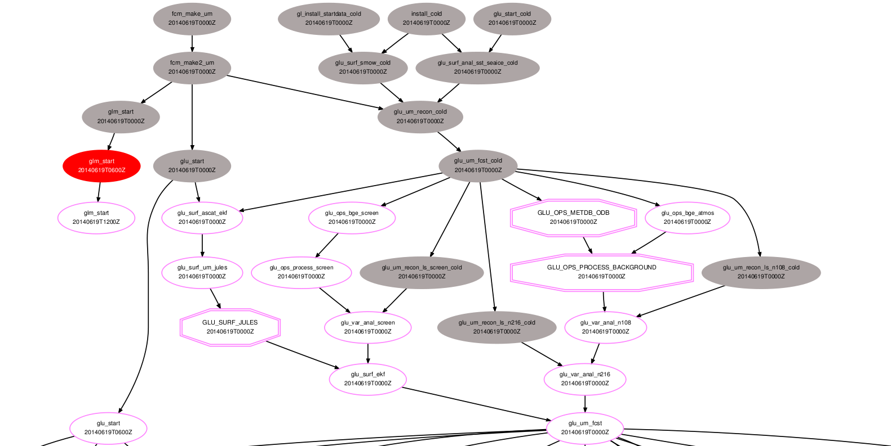
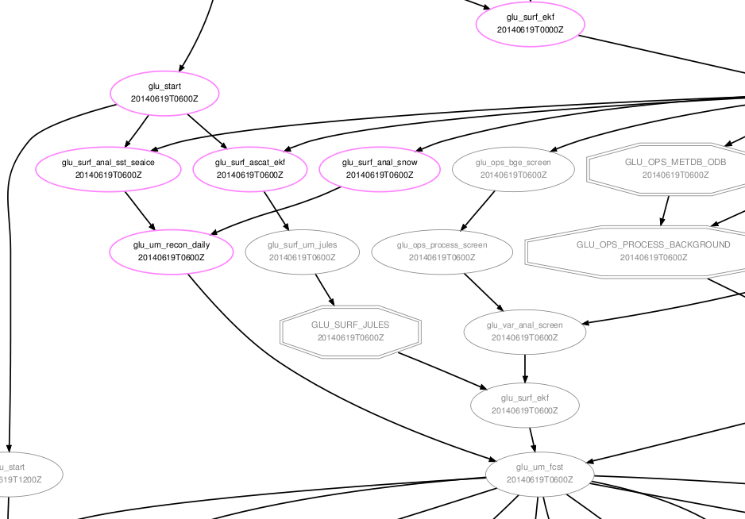
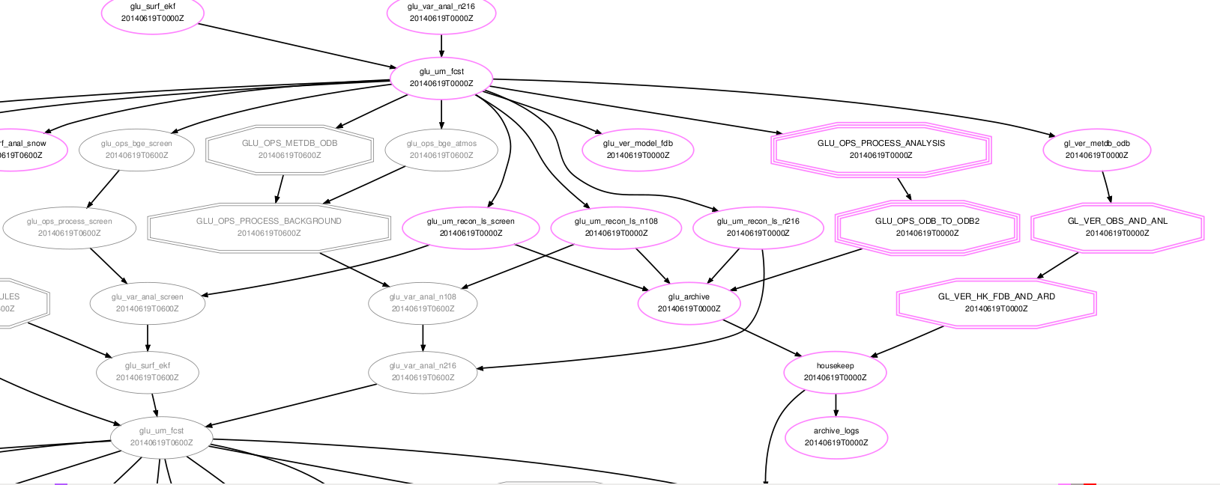
ACCESS-G3

Slide 10
ACCESS: APS1 → APS2
Current operational system is APS1(APS2)
APS = "Australian Parallel Suite” as per Met Office PS "Parallel Suite"
Currently upgrading APS1 to APS2
APS0 | PS17
APS1 | PS24
APS2 | PS32
APS3 | PS37
Notes:
APS0 PS17
APS1 PS24
APS2 PS32
APS3 PS37

Slide 11
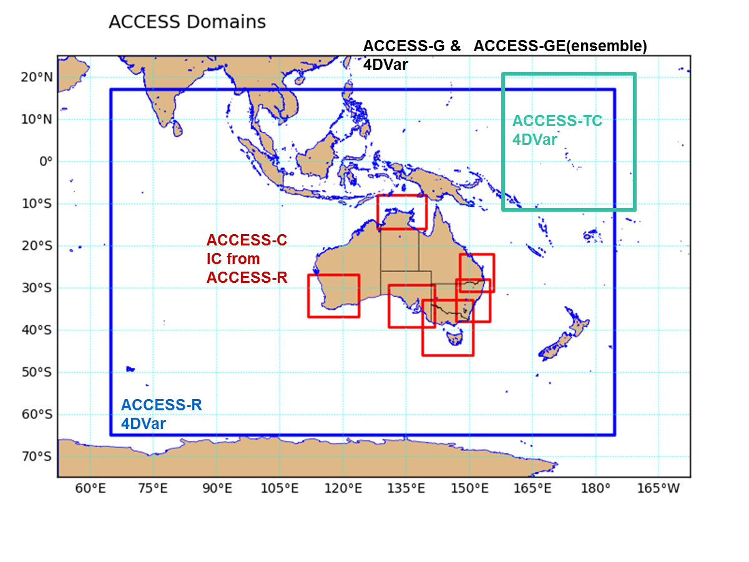
ACCESS: APS1 → APS2
70 vertical levels
Grid size (km)
 | APS1
G | 40
GE | -
R | 12
TC | 12
C | 4

Slide 12
ACCESS: APS1 → APS2
70 vertical levels
Grid size (km)
 | APS1 | APS2
G | 40 | 25
GE | - | 60
R | 12 | 12
TC | 12 | 12
C | 4 | 1.5
Notes:
GE: 24 members

Slide 13
ACCESS: APS1 → APS2
APS1 | Surface: synops, ships, buoys Sondes, wind profilers Aircraft: AIREPS, AMDARS
 | Satellite observations (1) Wind: Scatterometer surface winds (ASCAT), AMVs from GEOS & POES GNSS-RO: bending angle observations
 | Satellite observations (1I): IR and MW radiances
 | Platform | Instrument
 | NOAA-16 NOAA-17 NOAA-18 NOAA-19 MetOp-A EOS: Aqua | AMSU-A/B + HIRS AMSU-B + HIRS AMSU-A/B + HIRS AMSU-A/B + HIRS AMSU-A/B HIRS IASI (138 channels) AIRS (48 channels) (old instrument)

Slide 14
ACCESS: APS1 → APS2
APS2 | Surface: synops, ships, buoys Sondes, extra wind profilers Aircraft: AIREPS, AMDARS
 | Satellite observations (1) Wind: Scatterometer surface winds (ASCAT), AMVs from GEOS & POES GNSS-RO: bending angle observations
 | Satellite observations (1I): IR and MW radiances reduced thinning
 | Platform | Instrument
 | NOAA-18 NOAA-19 MetOp-A MetOp-B EOS: Aqua Suomi-NPP MTSAT-2 / Himawari-8 | AMSU-A/B AMSU-A/B AMSU-A/B + HIRS IASI (138 channels) AMSU-A/B + HIRS IASI (138 channels) AIRS (139 channels) CrIS (134 channels) ATMS Clear Sky Radiances / AMVs

Slide 15
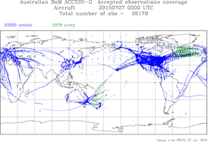
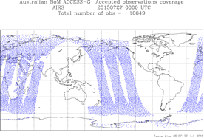
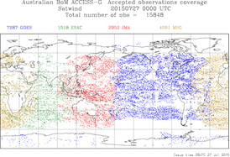
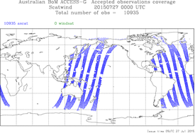
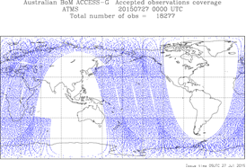
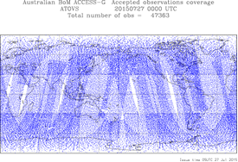
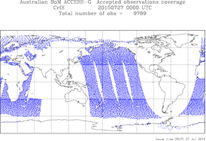
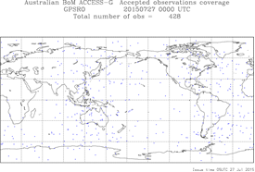
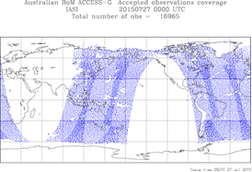
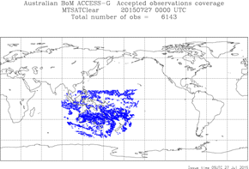
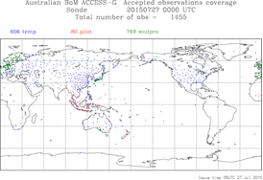
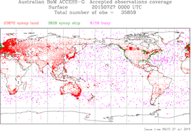
Global Observation Coverage: APS2 ACCESS-G

Slide 16
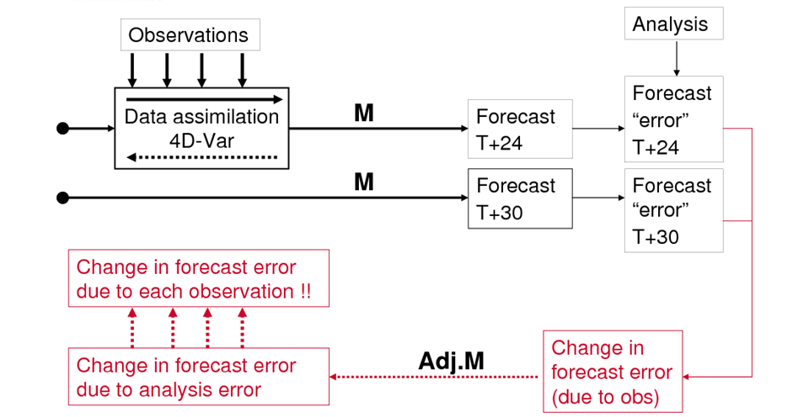
Adjoint-based Forecast Sensitivity to Observations (FSO)
Significant new technique in which the forecast error reduction in (say) a 24 hour forecast due to data assimilation can be split up and attributed to each individual observation.
Over several weeks, the reduction of forecast error due to observing systems, instruments, groups of observations etc. can be aggregated and compared.
Model
Model
Adjoint model

Slide 17
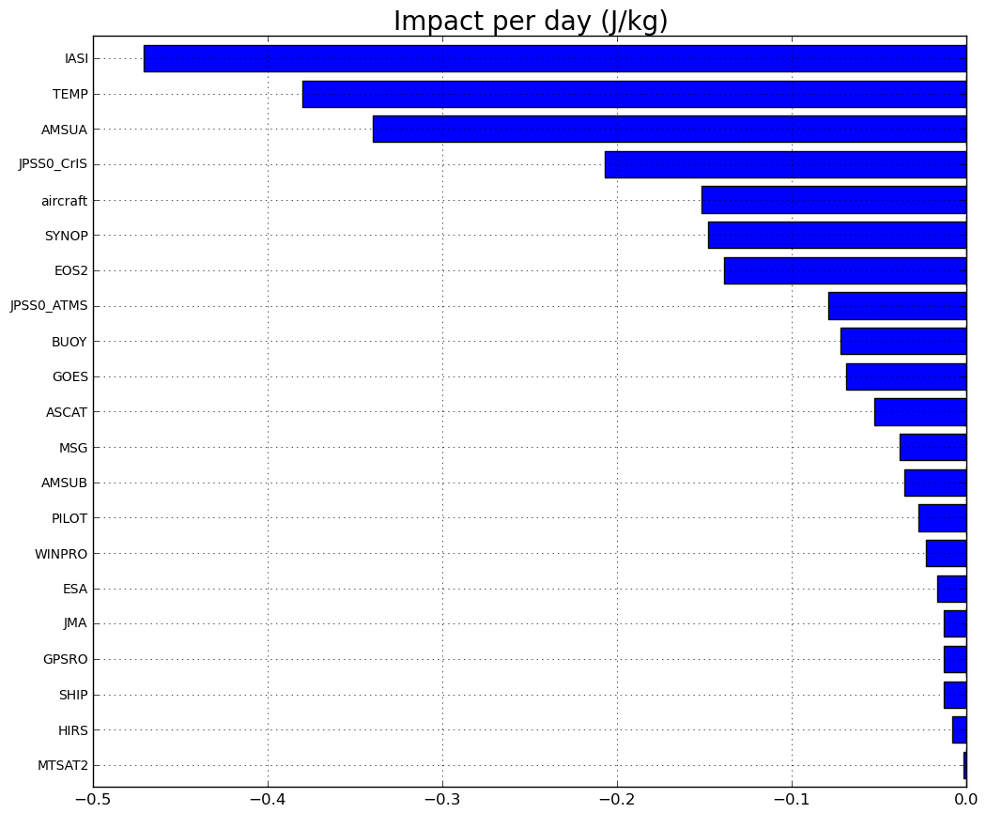
Forecast Sensitivity to Observations
IASI (IR)
SONDES
AMSU-A (MW)
CrIS (IR)
Aircraft
Synop
AIRS (IR)
ATMS (MW) BUOYS
NOAA AMVs
ASCAT
MSG AMVs
AMSU-B
PILOT (SONDE)
WIND PROF.
ESA AMVs
JMA AMVs
GPSRO
SHIP
HIRS
MTSAT2 IR

Slide 18
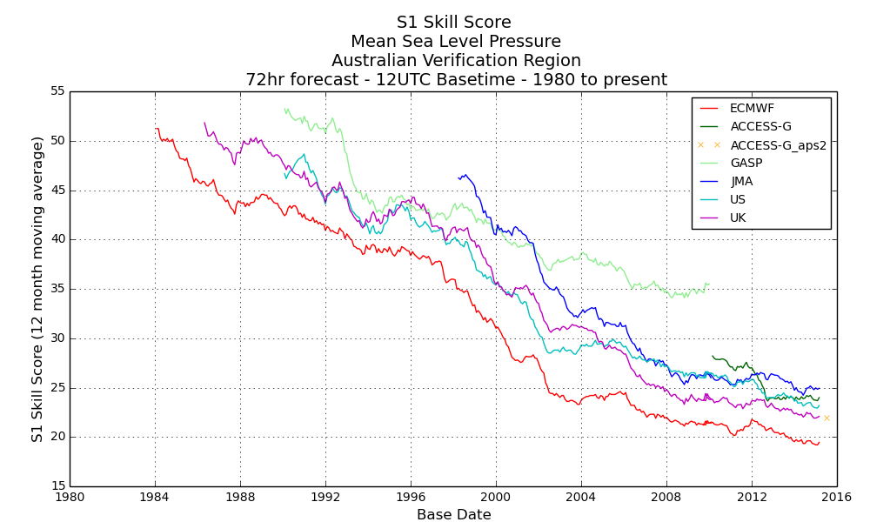
Long term Global Model Forecast Skill in the Australian Region
ACCESS
APS1
APS2

Slide 19
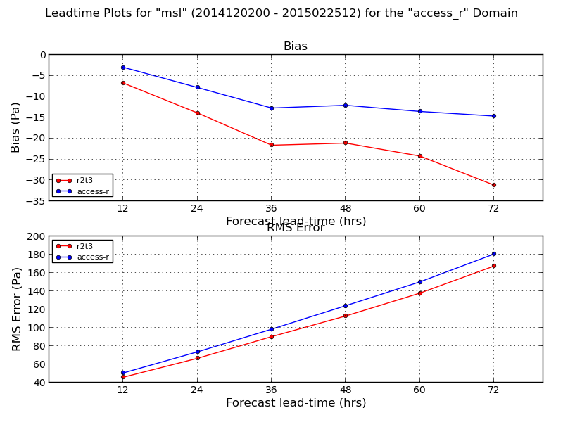
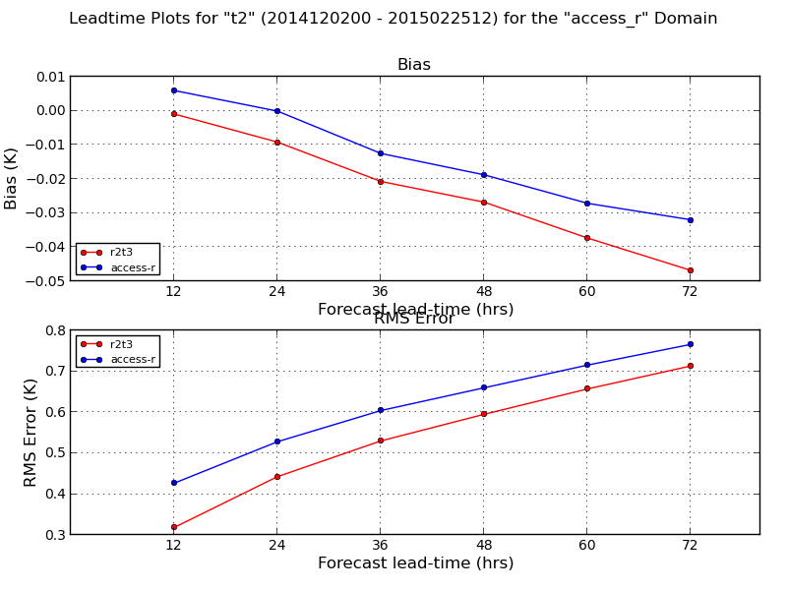
APS2 ACCESS-R
Regional model has same data-streams as global, UM is upgraded (8.4), but resolution unchanged
Improved land surface, R-domain-specific covariances
Verification shows more improvement than expected
Longer term uncertainty over regional-modelling
Notes:
19
"Uncertainty" – where does regional model fit between increasingly high-resolution global, and the city-based / on-demand very high-resolution systems ??? Can no longer rely on UKMO "NAE" model as a base.
"access-r" (blue) = operational system (R1)
"r2t3" (red) = trial APS2 ACCESS-R (R2) system
Mslp to left, screen-temperature to right. Be careful of the vertical-scales R2-Tscr has worse bias, but difference is small!

Slide 20
ACCESS-C in APS 3 and beyond
ACCESS-C 1.5 km domains will have their own assimilation cycles for the first time
Key systems for significant high impact weather forecasting
Hourly Rapid Update Cycle (RUC)
Assimilation of Radar data
Local Himawari-8/9 image processing and AMV generation will be essential to meet the low latency (~ 30 min max.) required by the RUC cycle

Slide 21
DRAFT ACCESS NWP Configurations
 | APS-2 (Op: 2016) | APS-3 (Op: Mid-2018) | APS-4 (Op: End-2020)
ACCESS-G | 25km {4dV} | 12km {Hy-4dV} | 12km {Hy/En-4dV}
ACCESS-R | 12km {4dV} | 8km {Hy-4dV} | 4.5km {Hy/En-4dV}
ACCESS-TC | 12km {4dV} | 4.5km {Hy-4dV} | 4.5km {Hy-4dV}
ACCESS-GE | 60km (lim) | 30km | 30km
ACCESS-C | 1.5km {FC} | 1.5km {Hy-4dV} | 1.5km {Hy/En-4dV}
ACCESS-CE | - | 2.2km (lim) | 1.5km
ACCESS-X (on demand) | - | 1.5km {Hy-4dV} | 1.5km {Hy/En-4dV}
ACCESS-XE | - | - | 1.5km
Operational date = full system
- Start rolling out operational systems about 12 months earlier
Notes:
FC = forecast only
Hy = Hybrid VAR.
En = Ensemble VAR

Slide 22
The future: challenges and promises
Development of higher resolution systems will be constrained by available R&D computing resources
initial development testing probably at lower resolution than target operational system
New more stringent security model requires a much more formalised, structured transition process to operations - managed by the Bureau's Information Systems & Services (ISS) division
More rapid development cycles: MOSRS should enable ACCESS to stay more closely in sync with Met Office Parallel Suites
challenge for collaboration partners to develop more interoperable NWP suites

Slide 23
Thank you …
Chris Tingwell
c.tingwell@bom.gov.au

Slide 24
Extra slides

Slide 25
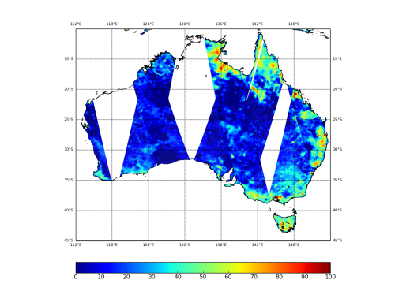
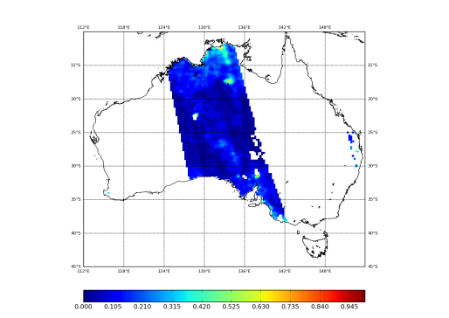
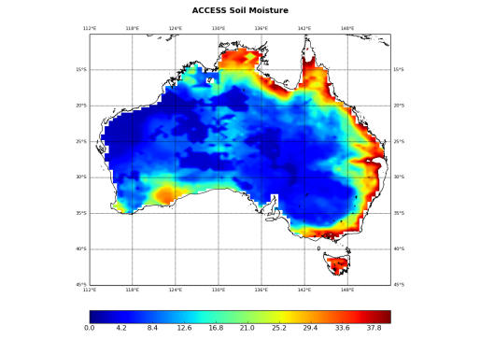
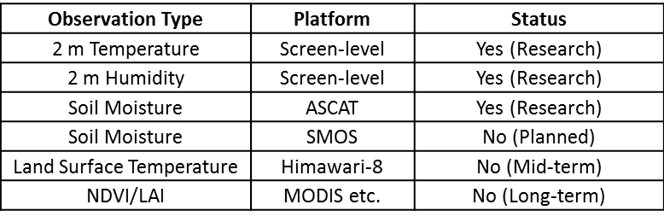
Land Data Assimilation System
Imtiaz Dharssi, Vinodkumar
ASCAT
SMOS
JULES LSM
Extended Kalman Filter
Offline soil moisture analyses at 5 km horiz resolution.
Initialise high resolution regional NWP systems.
Used for fire danger warnings.
Used in research mode, in operational use ~2016.
Built around the JULES land surface model (LSM).
Observation types and status:

Slide 26
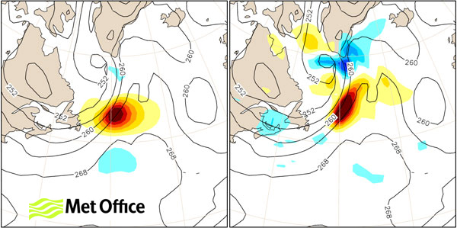
Better background errors: hybrid VAR
Current ("climatological")
"Hybrid"

Slide 27
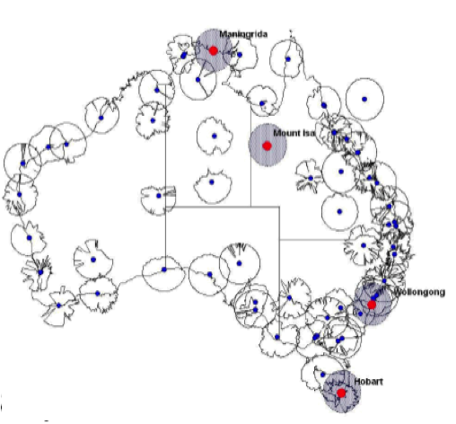
Assimilation in high resolution and convective scale NWP
Major effort to provide mesoscale (~1.5 km) city-based assimilation and prediction systems
Part of wider project to significantly upgrade Bureau’s generation and use of Radar data
Also driven by very high priority given to improvement of severe weather and hydrological forecasting
Radar assimilation (Doppler-winds, rain-rate via latent heat nudging)
3dVAR Rapid Update Cycle (RUC): ± 1hour assim window
Plans include a relocatable system for severe weather
Integration with other data including geostationary and polar-orbiter satellite radiances.
SREP: Strategic Radar Enhancement
Project
High resolution ACCESS NWP represents the priority ACCESS application for Himawari-8 data:
IR radiance assimilation to provide moisture information
Cloud top pressure data to constrain model convection
Locally received and processed moisture sensitive microwave data (e.g. MHS) will also be assimilated

Slide 28
Radar Data Assimilation
Radar+Gauge 10min Accumulation→ Latent Heat Nudging & cloud
T-1
T-0.5
T+0
T+0.5
Obs
Analysis increments
IAU

